Slide 1


Interactive Resume Builder
Student Name: Swetha.G
RegisterNo & NMID:4336D50D8CC13609D5346EA63A81AA93 Department: B.Sc CS WITHAI College: SRM Arts and ScienceCollege University: Madras University

Slide 2

Project title
InteractiveResume Builder
Using HTML, CSS & JavaScript
"Because your career deserves more than a plain PDF"
Presented by : Swetha

Slide 3


AGENDA
1. Problem Statement 2. Project Overview 3. Objectives of the Project 4. End Users 5. Tools & Technologies 6. System Architecture / Workflow 7. Resume Design & Layout 8. Features & Functionality 9. Results & Screenshots 10. Advantages & Limitations 11. Future Scope 12. Conclusion 13. GitHub Link

Slide 4

Problem statement
1. 2. 3. 4.
Traditional resumes are static and hard to update.
Students struggle with formatting and design.
Recruiters prefer professional, standardized formats.
Need a simple, interactive web tool to generate resumes quickly.

Slide 5
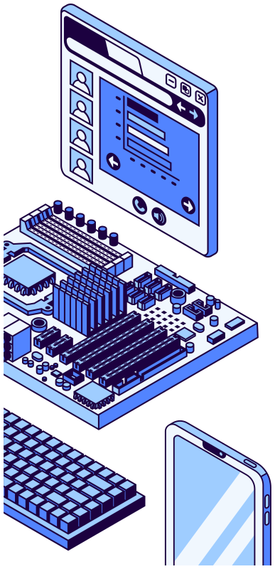


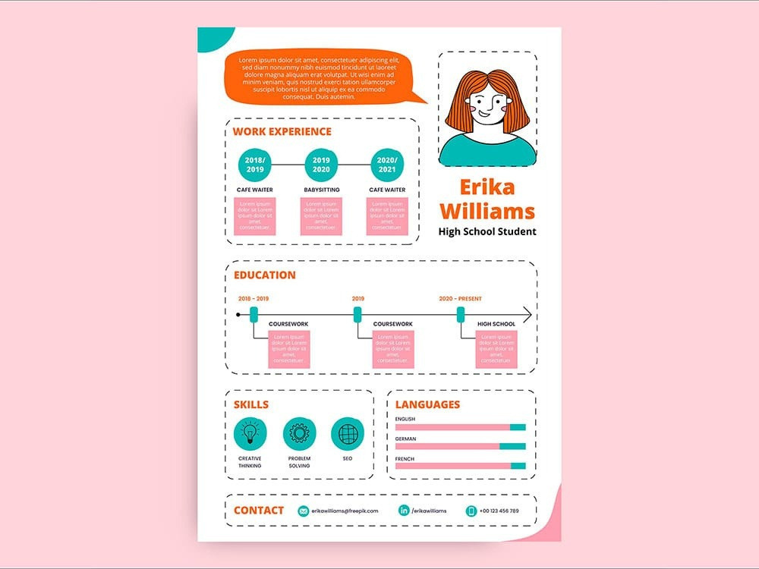
Project Overview
A web application that
Automatically generates a formatted, professional resume.
Provides real-time preview and download as PDF.
allows users to enter
their details.

Slide 6


To create a user-friendly platform for resume generation. To provide customizable templates for different job roles. To ensure resumes are mobile-friendly and accessible.
To allow quick updates anytime.
Objectives of
the Project

Slide 7

End Users
Students&Freshers→forcampusplacements &
internships.
Professionals → for updating resumes quickly.
Freelancers → to send quick resumes to clients.
Recruiters → can guide candidates to use this tool.

Slide 8


Tools & Technologies
HTML5 → Structure of input forms & resume Layout. CSS3 → Styling, colors, and professional formatting. JavaScript → Dynamic interactivity & PDF generation. Bootstrap / Tailwind CSS → For responsive design. GitHub Pages / Netlify → For deployment & hosting.

Slide 9


System Architecture / Workflow
1. User Input → Name, Education, Skills,
Projects, Contact Info. 2. Processing (JavaScript) → Data mapped to template. 3. Output (Preview) → Live interactive resume displayed 4. Export → Resume downloaded as PDF or shared online.

Slide 10



Resume Design & Layout
Sections Included: Personal Details Education Skills Projects & Experience Certifications Contact Info

Slide 11

Easy form-based input. Real-time preview while typing. Multiple templates to choose from. Dark/Light mode option. PDF Download & Print feature.
Responsive→workson mobile& desktop.
Features &
Functionality

Slide 12


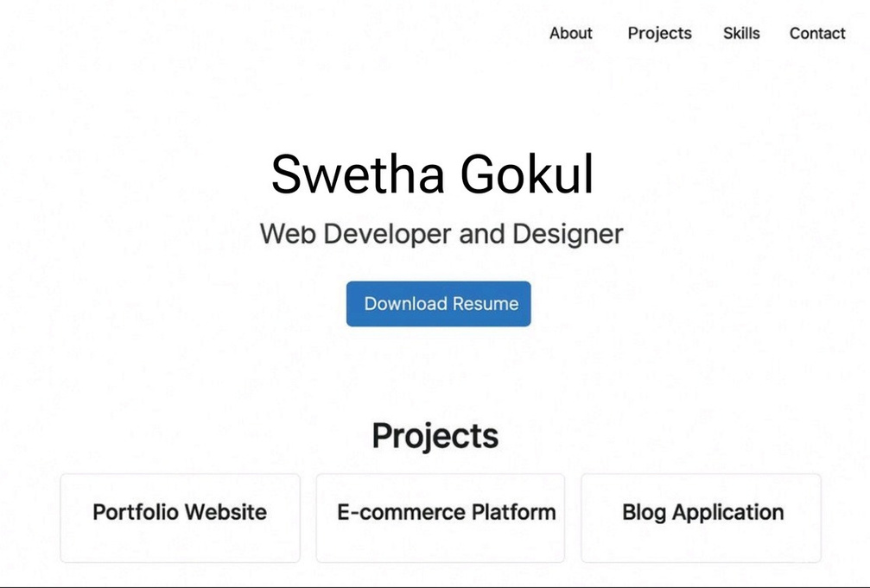
Result and Screenshot

Slide 13
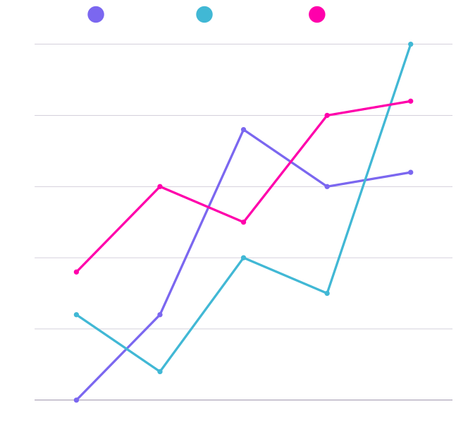
Advantages & Limitations
Series 1
Series 2
Series 3
50
40
Advantages:
Savestime andeffort. Professional designswithoutneedingMSWord. Works online (accessible anywhere). Easy customization.
30
20
Limitations: Limited templates compared to premium tools. Requires internet connection (if hosted online). Advanced features (like AI-suggestions) not included yet.
10
0
Item 1
Item 2
Item 3
Item 4
Item 5

Slide 14


Future Scope
Add AI-based suggestionsfor
skills &resume improvements. Integration with LinkedIn / job portals. Allow multi-language resume generation. Cloud storage for saving multiple resumes. Export to Word/Google Docs in addition to PDF

Slide 15

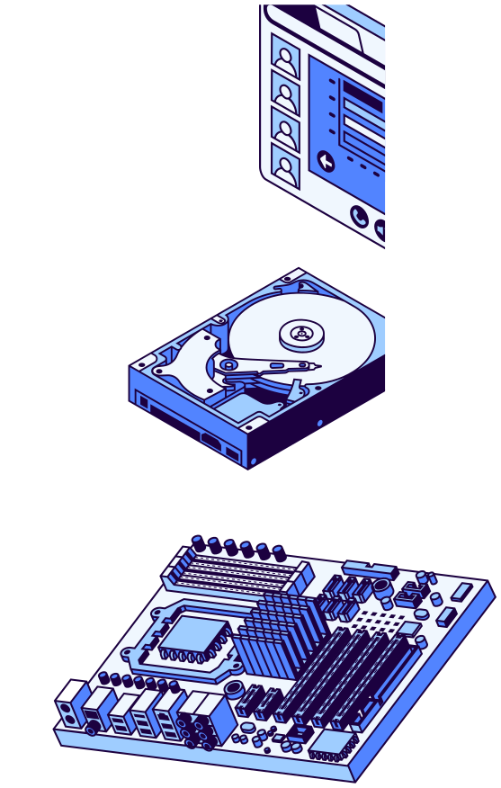

Conclusion
The project provides a smart,
simple, and effective way to build resumes. Solves a real-world problem faced by students and job seekers. Easy to expand with more templates and AI features in the future. A step toward digital, professional career tools.

Slide 16


GitHub link
Sourcecodeofthe projectisuploadedtoGitHub.
Publicly available for viewing and contribution.
Helps in version control & portfolio building.
swethagomadhi23-oss/TNSDC-FWD-DP-

Slide 17

Thank You

